Slide 1


Iteration IIII
Team The Best Team

Slide 2
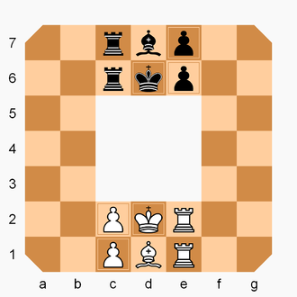
Quick Recap
Rollerball is a variant of chess based off of the 1975 film.
Each player starts with a King, Bishop, two Rooks, and two Pawns
Players move their pieces clockwise to capture the opponent’s king or placing your King in the opponent King’s starting position to win the match.

Slide 3
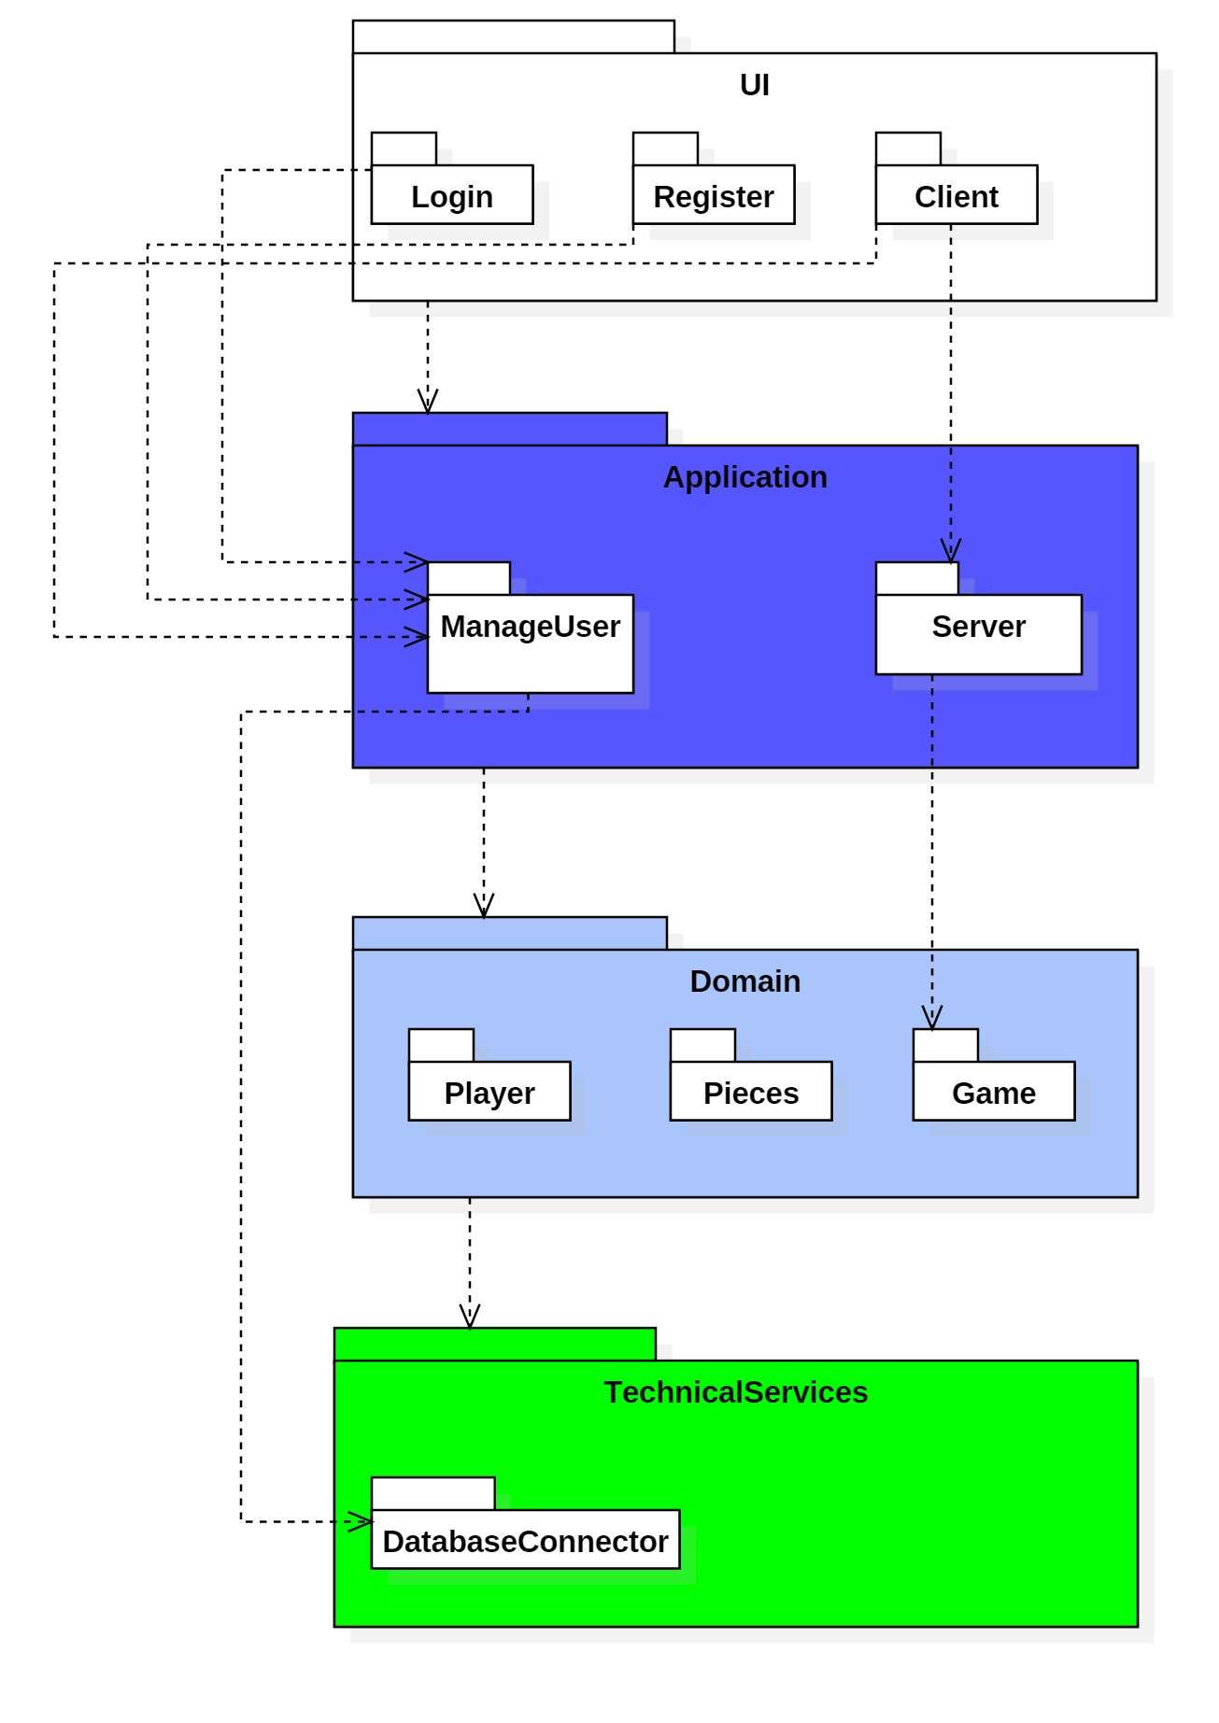
Package Diagram

Slide 4
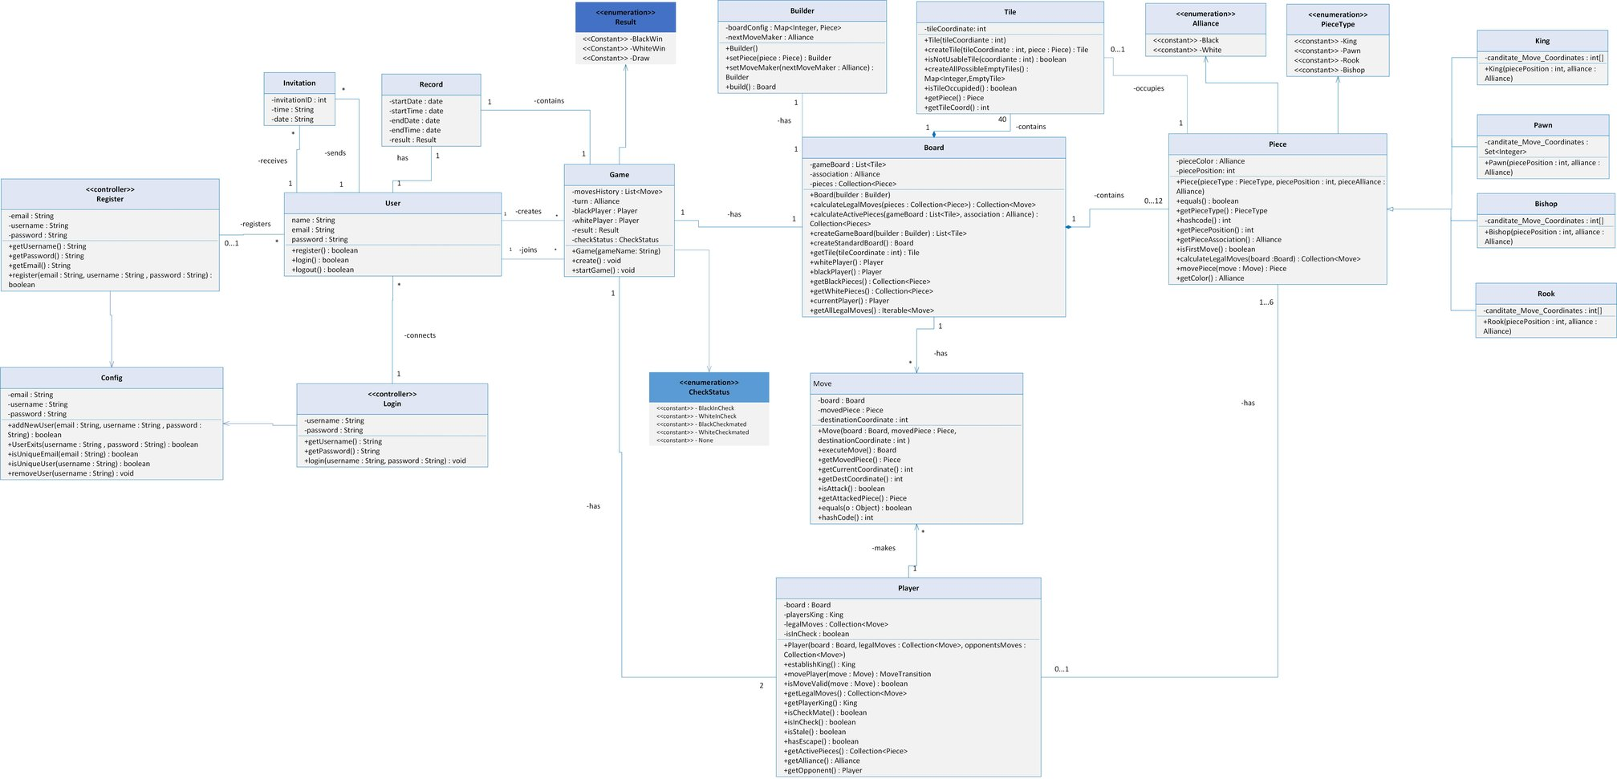
Old Design Class Diagram

Slide 5
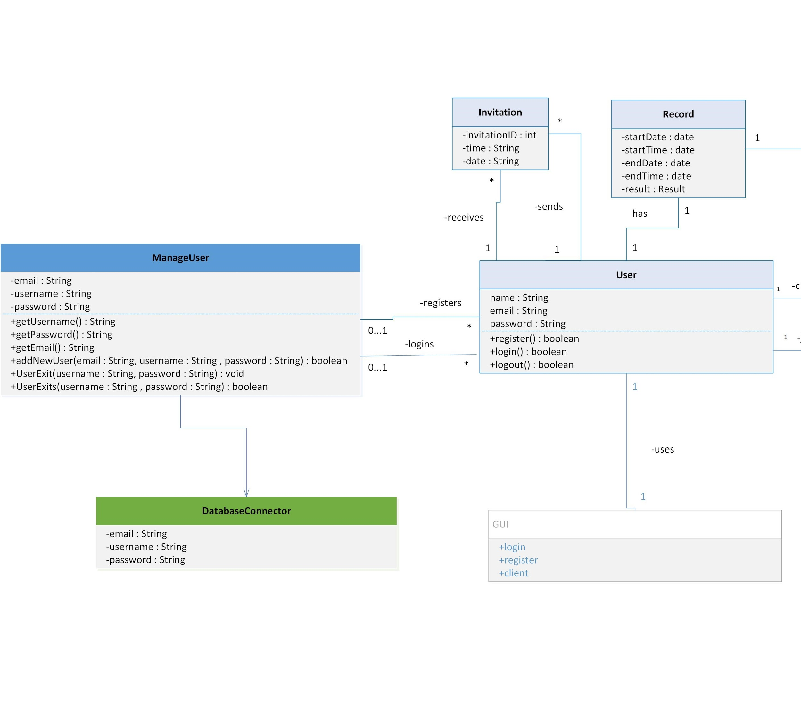
Design Class Diagram

Slide 6
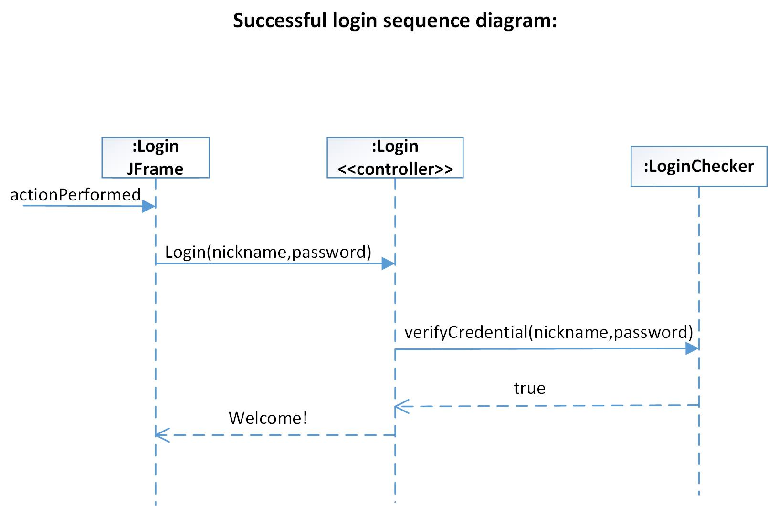
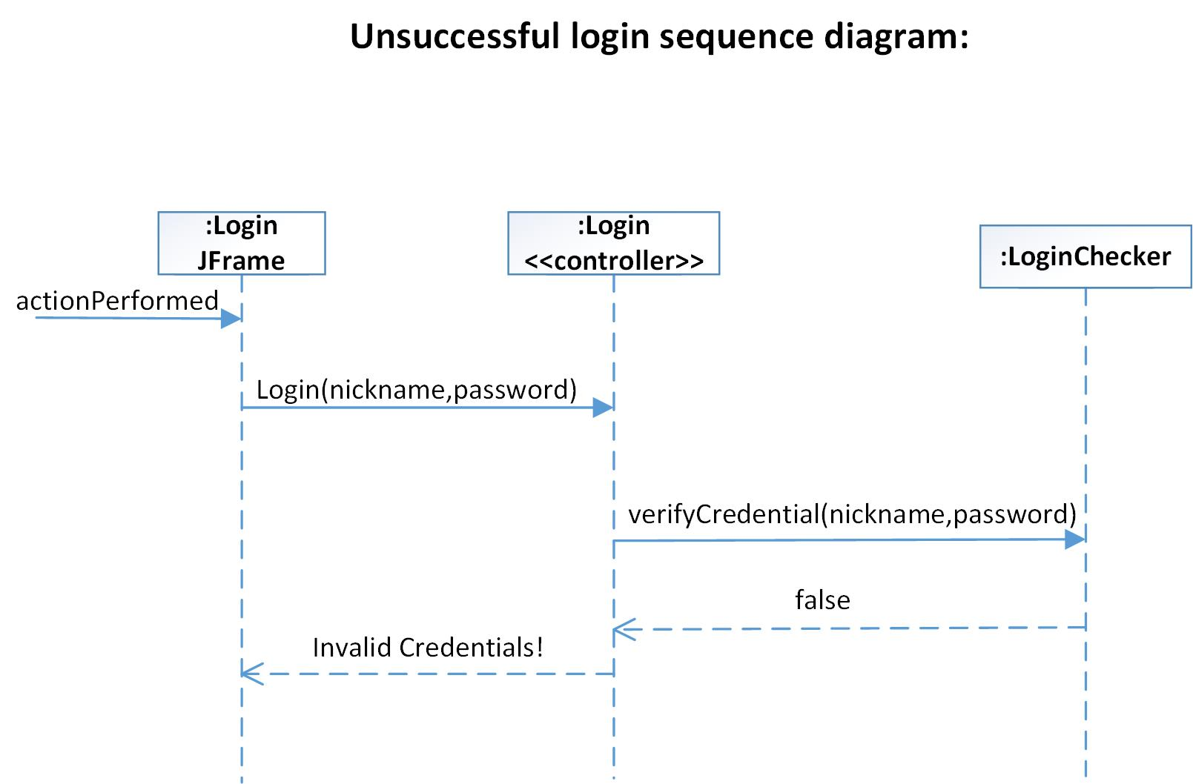
Old Sequence Diagram

Slide 7
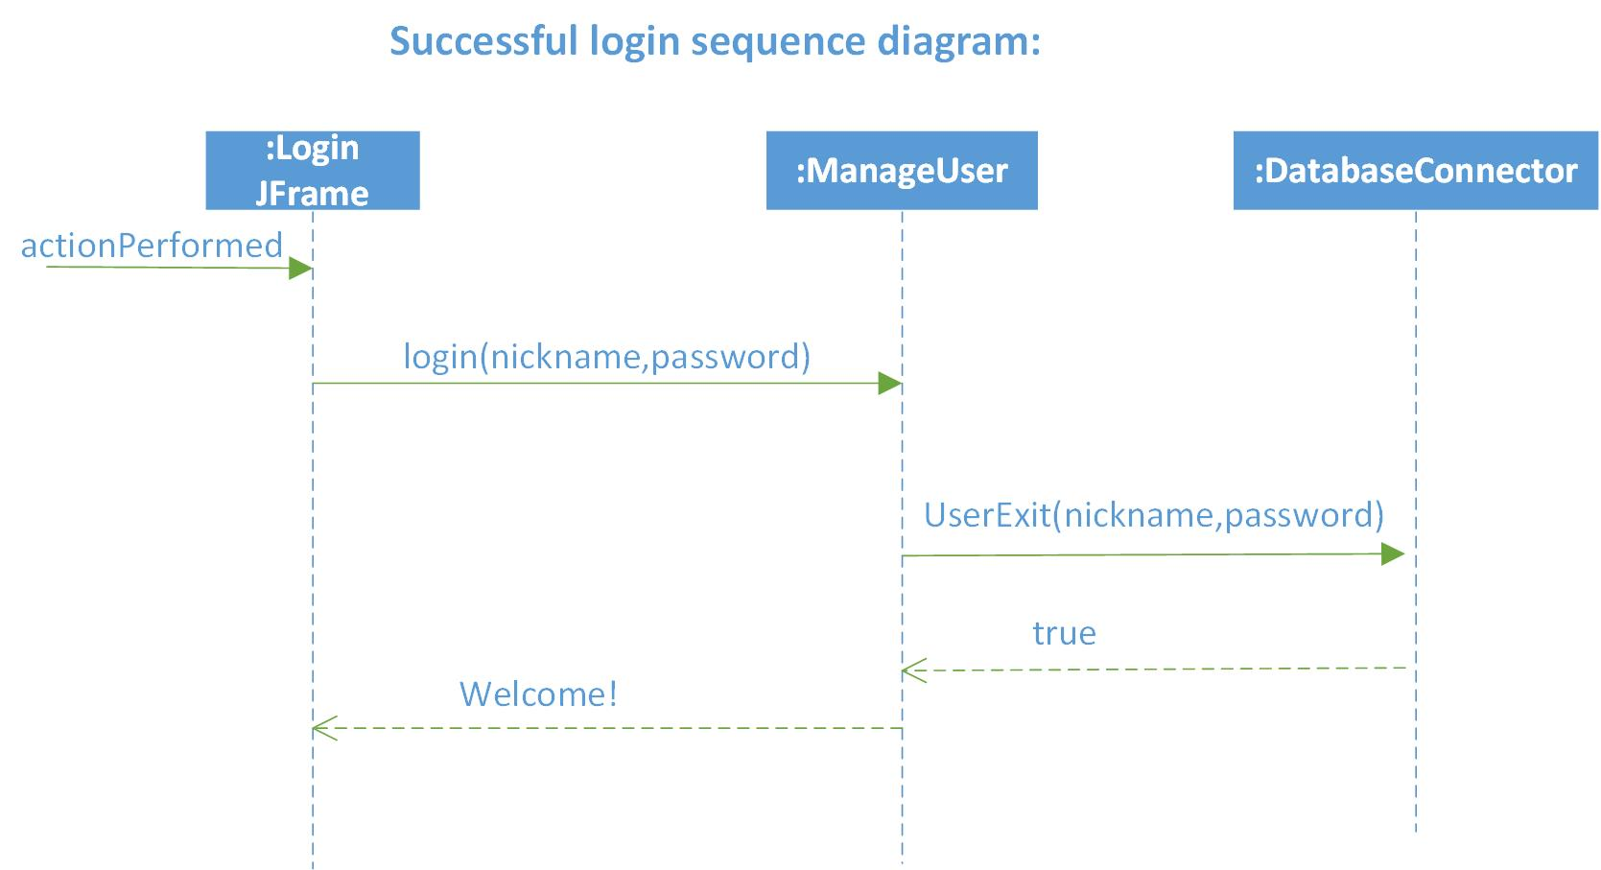
Sequence Diagram

Slide 8
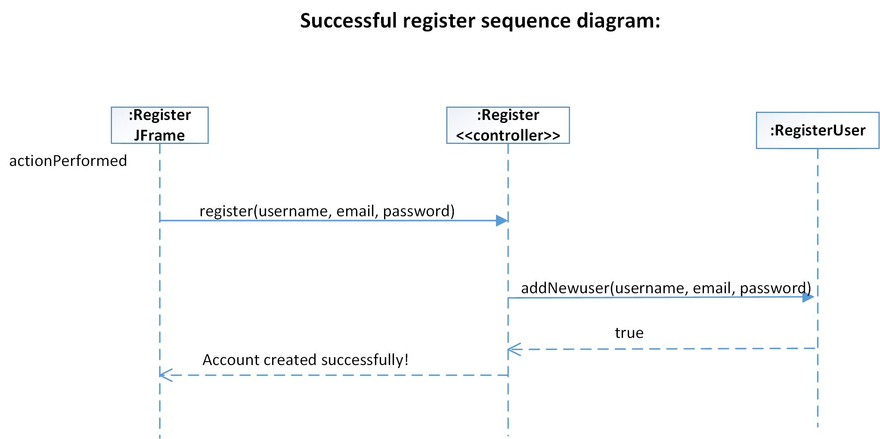
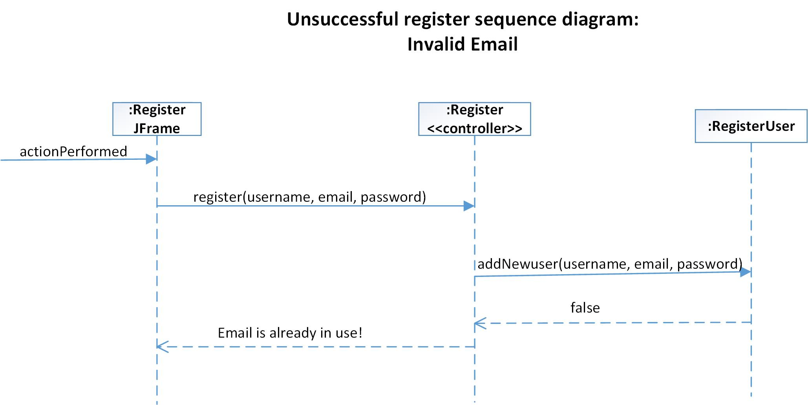
Old Sequence Diagram

Slide 9
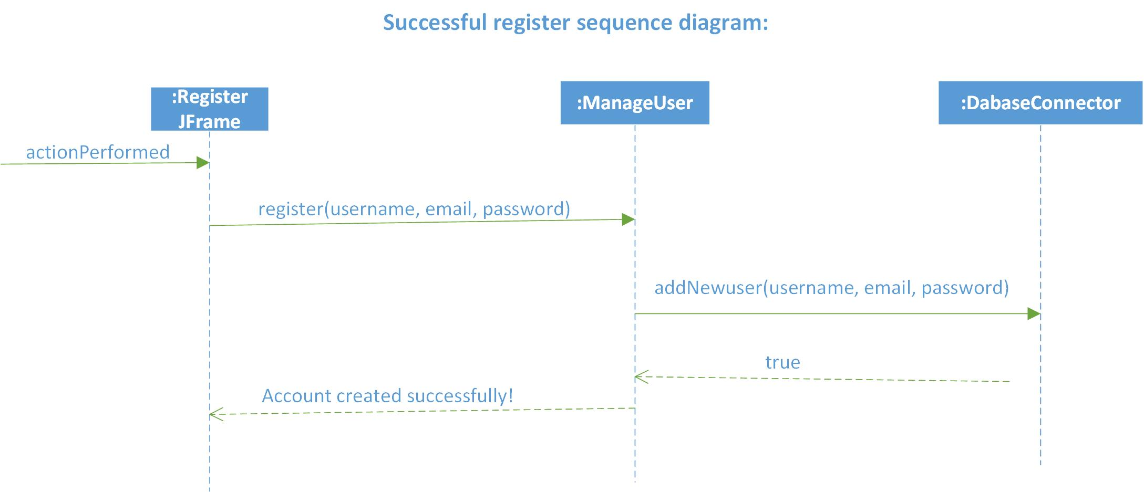
Sequence Diagram

Slide 10
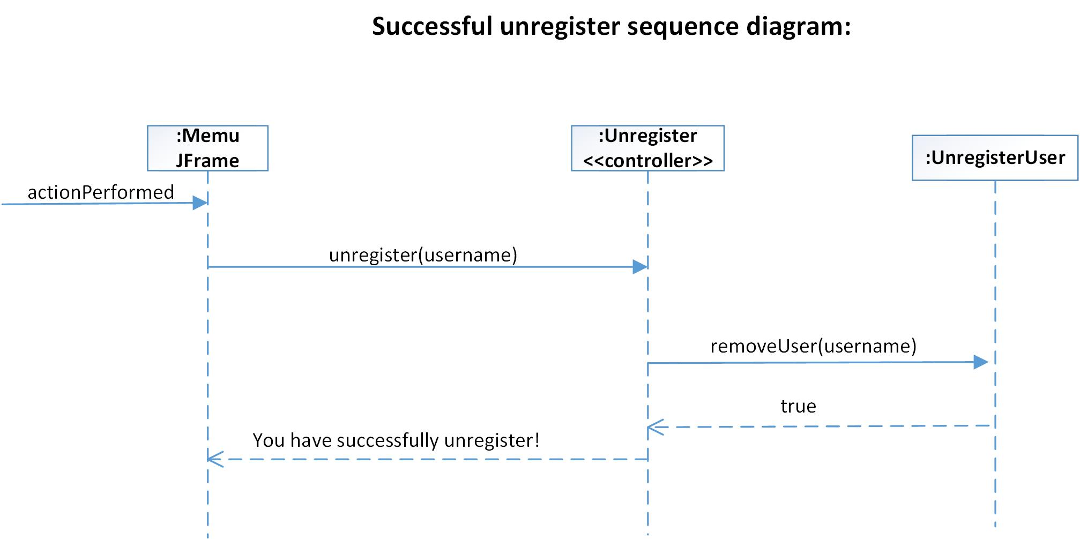
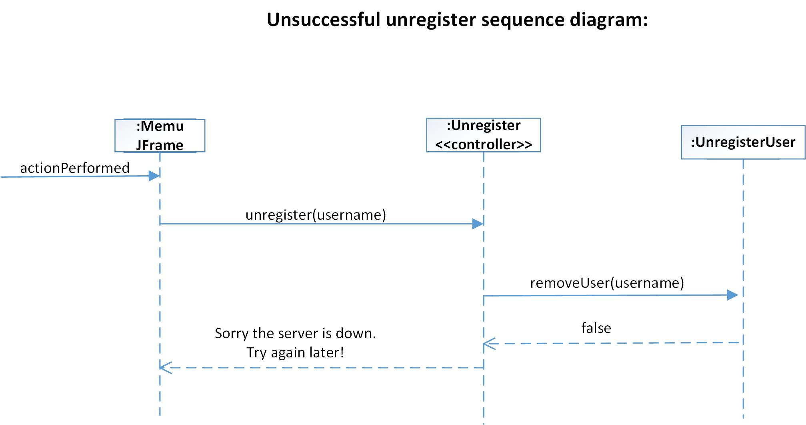
Old Sequence Diagram

Slide 11
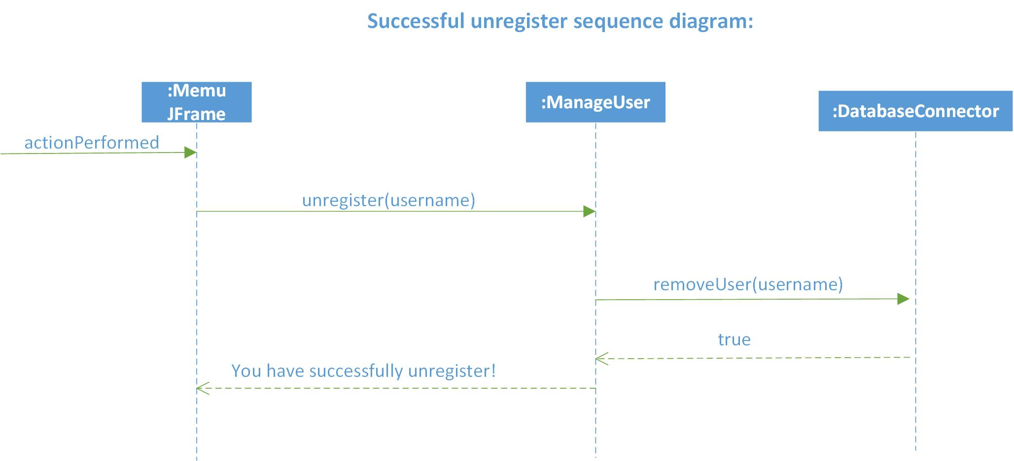
Sequence Diagram

Slide 12
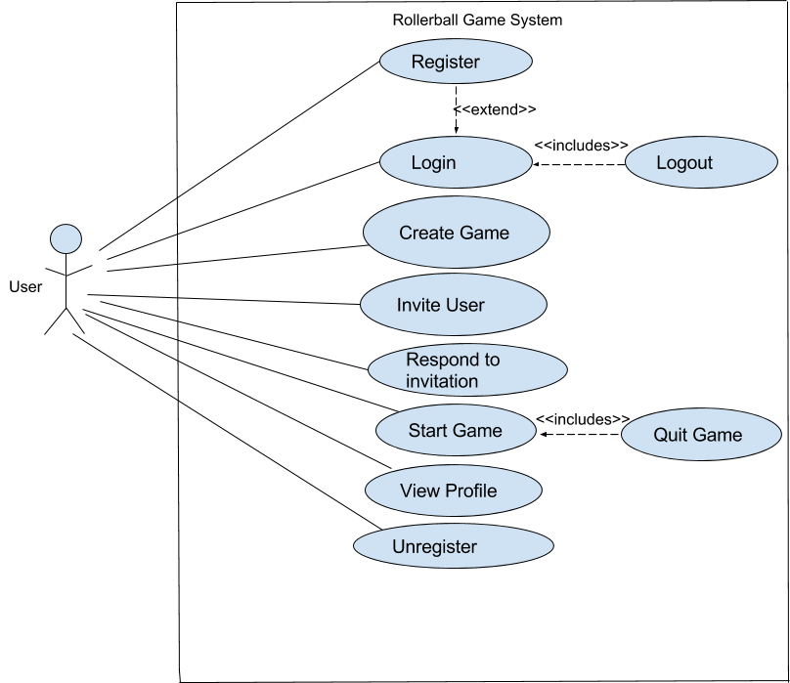
Use Case Diagram

Slide 13
System Test Cases Completed
System Test | Pass/Fail
Login | Pass
Logout | Pass
Register | Pass
Unregister | Pass
Respond To Invitation | Pass
Start Game | Pass
Quit Game | Pass
View Profile | Pass
Create Game | Pass
Invite User | Pass

Slide 14
Test Case
Step | Action | Expected System Response | Pass/Fail | Comment
1 | Enter Username “test” | Nothing
2 | Enter password “password” | Nothing
3 | Click “Login” | Notification user is logged in | Pass
 | Alternative Flow: Incorrect credentials
4 | Enter Bad Username “tste” | Nothing
5 | Enter Bad Password “psswd” | Nothing
6 | Click “Login” | Notification of Bad Input | Pass | Asks to register this user
Pre-Conditions: User is Registered already with credentials username: “test” password: “password”
Test Case #: 1 System: Rollerball Designed by: Nik F Executed by: Nik F | Test Case Name: Try to Login Subsystem: Login Design Date: 10/14/17 Execution Date: 10/14/17
Short Description: See if login system works.
Post-Conditions: User is now logged into the system

Slide 15
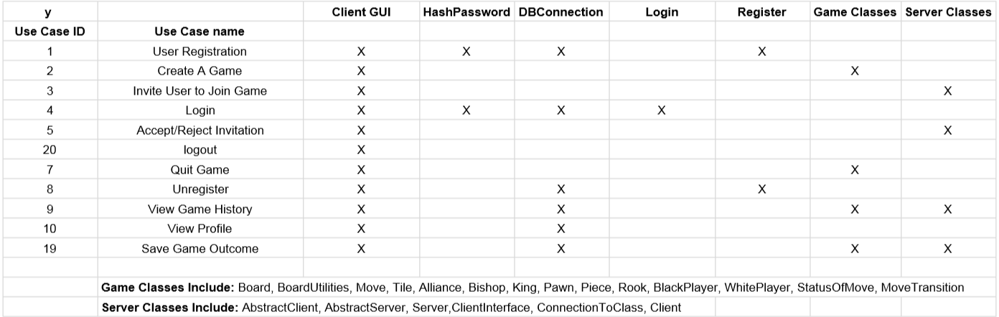
Traceability Matrix

Slide 16
Tools & Challenges
What we’ve used so far:
GitHub for our remote repository
Eclipse as our IDE with git plugin
MySQL and MySQL Workbench for our database
JavaSwing for the Graphical User Interface
Challenges we’ve faced:
Synchronization issues multiple boards and GUI

Slide 17
Questions?
Thank you

